Slide 2

Victoria C.P. School
Hands up survey results 2016-17

Slide 3
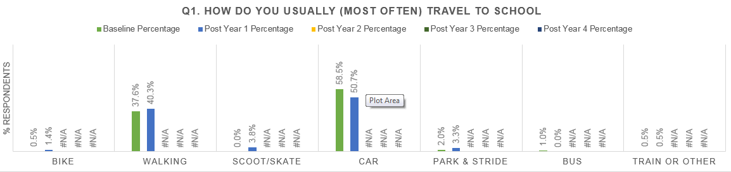
Car use reduced by 7.8%

Slide 4
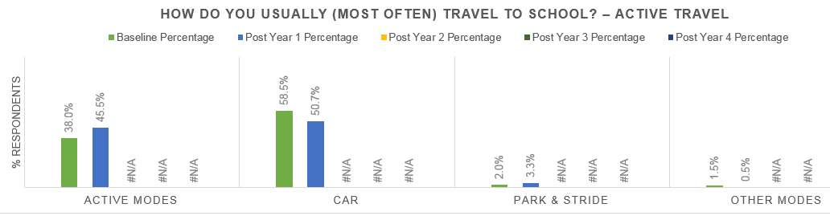
Active Travel total increase of 7.5%

Slide 5
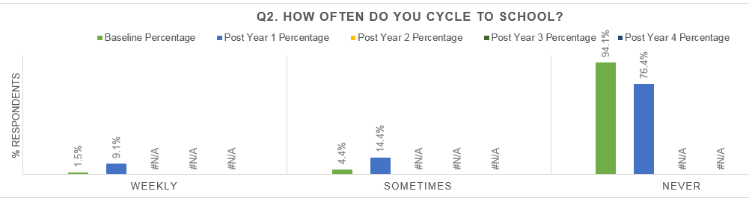
Cycling has increased Weekly +7.6% , Sometimes +10%

Slide 6
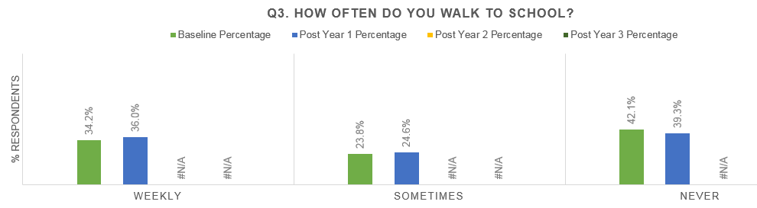
Walking has also increased

Slide 7
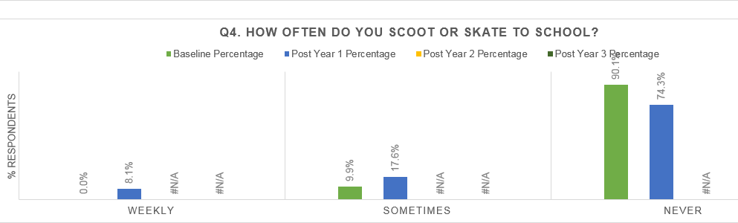
Scooter use has increased by 8.1% Weekly and 7.7% Sometimes

Slide 8
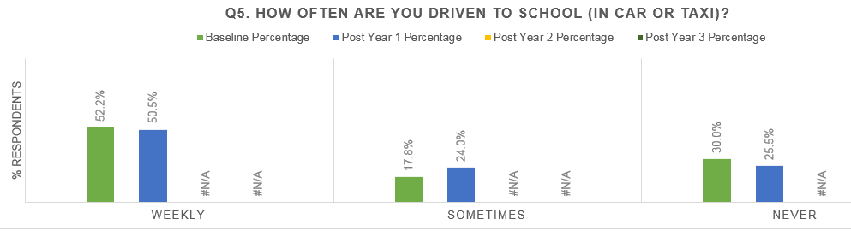
Numbers being driven to school weekly has reduced by nearly 2%

Slide 9
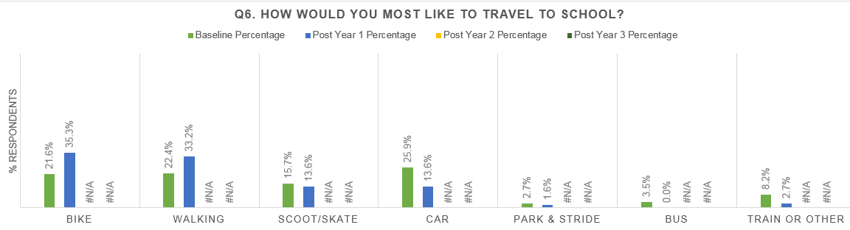
Walking and cycling have become more popular

Slide 10
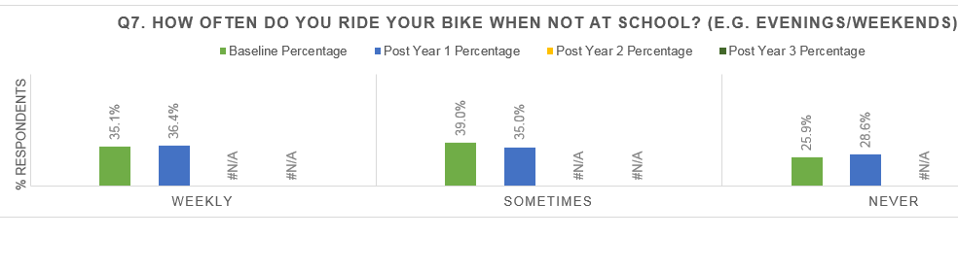
Some pupils are spending more time on their bikes outside of the journey to school

Slide 11
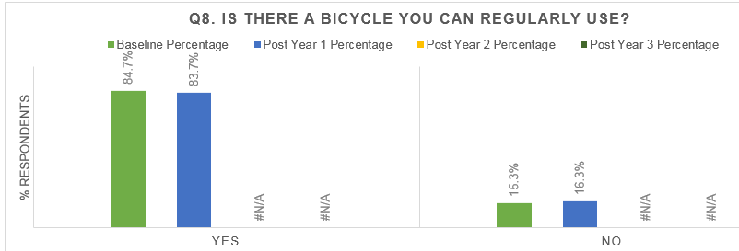
A small fall in bike ownership or access

Slide 12
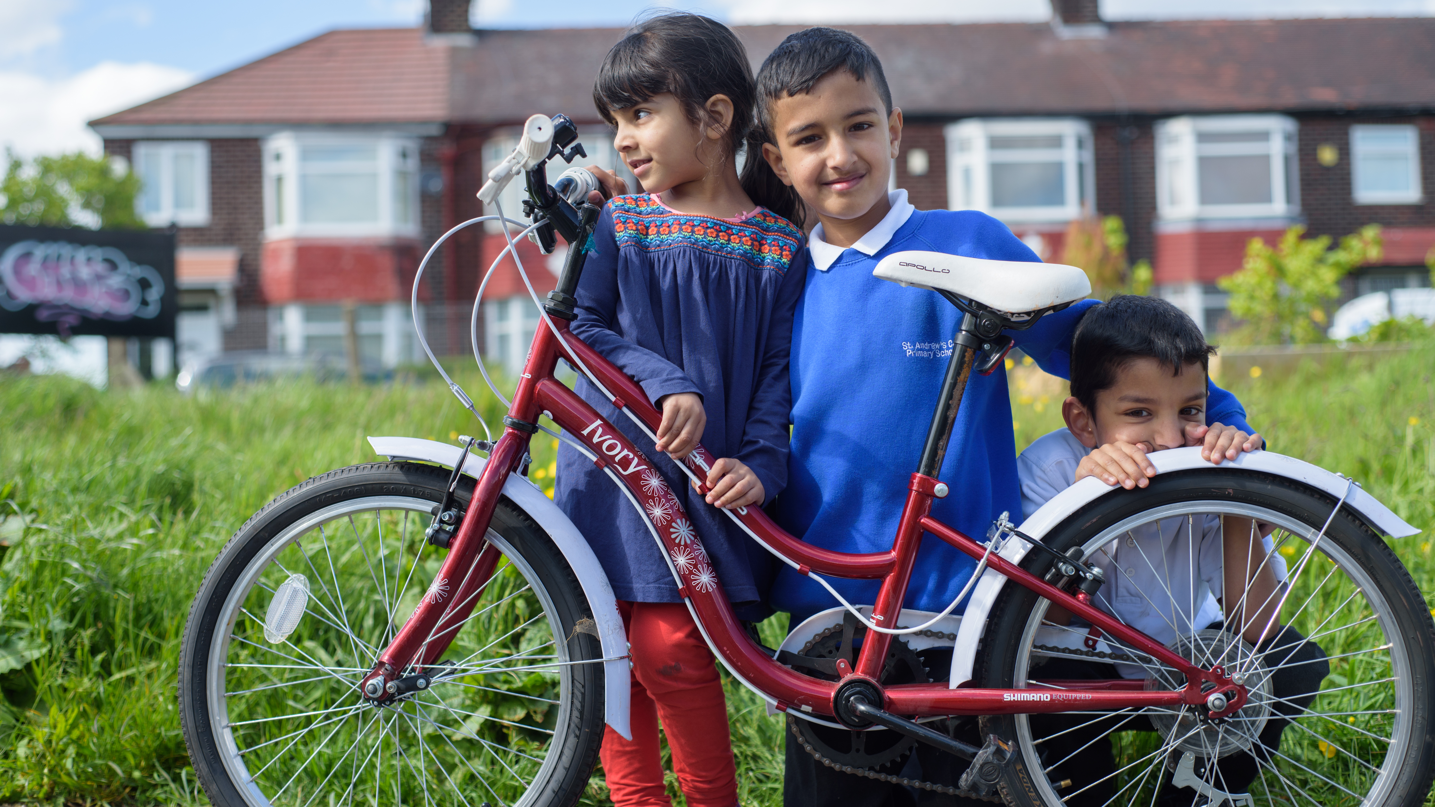
A big thank you for encouraging and supporting Active Journeys to your school

Slide 13
Sustrans is the charity making it easier for people to walk and cycle. We connect people and places, create liveable neighbourhoods, transform the school run and deliver a happier, healthier commute.
Join us on our journey. www.sustrans.org.uk
Twitter @sustrans
www.sustrans.org.uk

Slide 14
Sustrans yw’r elusen sy’n ei gwneud yn haws i bobl gerdded a beicio. Rydym yn cysylltu pobl a llefydd, yn creu cymunedau byw, yn trawsnewid y daith i’r ysgol ac yn hwyluso taith hapusach ac iachach i’r gwaith.
Ymunwch â ni ar ein siwrne. www.sustrans.org.uk
Twitter @sustrans
www.sustrans.org.uk

