Slide 1


Tîm Iechyd Cyhoeddus Betsi Cadwaladr
Betsi Cadwaladr Public Health Team

Slide 2

What is The Solihull Approach?
The Solihull Approach is a not-for-profit NHS organisation promoting emotional health and well-being by supporting relationships. Established in 1996
Track record of providing highly acclaimed training courses to over 25,000 professionals in over 80 areas of the UK and further afield, within Health, Education and Social care
The Solihull Approach is included in the UK Department of Health’s Healthy Child Programme
Nationally and Internationally acclaimed face to face courses for parents, carers and grandparents
Evidence based, accredited, online courses from pre-birth to adolescence, developed with practitioners and parents, tested in the field and with an ongoing research programme
Results are already showing a decrease in conflict in the home, and increase in closeness of relationships

Slide 3
What’s on offer?
BCUHB PUBLIC HEALTH TEAM HAVE PURCHASED A MULTI-USER LICENCE VALID UNTIL END NOVEMBER 2022 WHICH ENABLES:
FREE ACCESS FOR ALL NORTH WALES RESIDENTS TO 4 ONLINE COURSES FOR PARENTS, PARENTS-TO-BE, AND CARERS
Understanding your Pregnancy, Labour & Birth
Understanding your baby
Understanding Your Child 0-18 yrs
Understanding your teenagers brain

Slide 4
Solihull Approach Models & Aims (1)
The Solihull Approach aims to increase emotional health and well-being through both practitioners and parents. It does this through resources and training across the child and family workforce
It provides a framework for understanding and supporting the development and maintenance of sensitive, attuned relationships between parents and their infants/children
Emotional attunement in turn enables infants/children to develop emotional and behavioural self-regulation skills for life, thereby increasing long-term resilience and mental health and wellbeing
The majority of health visitors in the UK are now trained in the Solihull Approach model. Child and family practitioners from midwives to schools to social workers are being trained in the model. It has been taken into prisons, and the police and fire services

Slide 5
Solihull Approach Models & Aims (2)
Particular features of the Solihull Approach are:
It is used for workforce development: increases skills and knowledge, consistency and shared language across agencies using the Solihull Approach
It can be used for early intervention and prevention in the early years
It can be used for everyone in a team e.g. children’s centre, parent and baby unit, school (from receptionists to support staff to teachers)
It provides parenting programmes from conception through to adolescence
It has a particular emphasis on including fathers
It increases the accessibility of parenting programmes through online courses, which have the same content as the face to face groups
It provides a theoretical framework for working with emotional and behaviour difficulties and provides supporting evidence e.g. for Ofsted

Slide 6

Brain development and the importance of early relationships
Research shows that the brain has its most prolific period of growth and development during conception and the first three years. This is why it is so important to give the right support to families early on
Attachment theory explains how the ways of relating to others learned in our earliest relationships (attachment pattern) become a blueprint for all future relationships
Containment and Reciprocity (cornerstone theories in the Solihull Approach model) are the building blocks of a secure attachment pattern
Supporting families with Containment and Reciprocity therefore promotes secure attachment patterns and positive relationships

Slide 7
What Parents think
“This has been a really valuable experience that in a way will impact on many aspects of my life”
“This course has been an absolutely invaluable gift to me. It has and will change so many aspects of my life. I am undoubtedly a better parent and more rounded and fulfilled person as a result. Some aspects have literally been like ‘Eureka’ moments to me! I WISH I’d known all this years ago”
“The Solihull Approach course I did made it clear parents don’t need lessons: daily life throws us enough of those. What we need is the space to step back and observe our children. We need some structured guidance to help us reflect on all the factors that make them behave the way they do; some developmental, some circumstantial.”
“I have found the online course very useful. Now, I take time to think more during difficult situations and during arguments with my kids.”
“It doesn't work all the time but bit by bit, we are working towards a less confrontational household!”

Slide 8
Benefits to Parents & Carers
Increased confidence
Decreases in conflict in the relationship with their child
Increased closeness in the relationship
Calmer household, better behaved children
Able to recognise own emotions and seek support
Improved couple relationship
Approach situations thoughtfully, better able to see things from their child’s perspective
Increased understanding of child development
Up to date knowledge for parents and grandparents

Slide 9
Population Benefits
Uplift in the emotional health of the next generation
Improved emotional health and wellbeing by supporting relationships
Inoculation against future mental health problems
A shift in culture away from ‘bad behaviour’ and ‘command and control’ models of parenting towards recognising behaviour as a communication and supporting children to develop emotional and behavioural self-regulation skills
Babies seen as needing support with emotional as well as physical development
Emotional intelligence from an early age

Slide 10
Benefits to Children
Calmer parents, happier households
Less conflict, more closeness
Attuned sensitive care, more empathy by adults around them
Tailored boundaries which take into consideration individual needs
Develop ability to articulate, share and ultimately manage own emotions
Resilience against mental health problems
Emotional intelligence

Slide 11
How does Solihull differ to other parenting programmes?
Most modern parenting programmes now include a consideration of emotional wellbeing and relationships. And all these programmes can complement each other.
Whereas most parenting programmes have a targeted approach, Solihull is also being delivered as a universal programme reaching wider audiences.
Solihull Approach courses for parents are available online, with non-expiring access once registered. Many other parenting programmes are not available online.

Slide 12
How it works
Public launch 29th April 2020
Follow instructions to click through to www.inourplace.co.uk
Access code will be forwarded on to you on the 27th April 2020 ahead of the launch PLEASE DO NOT SHARE CODES UNTIL 29/4/20
Once parents have created an account they enter select the course they wish to access and enter the relevant code
Their account remembers that they have access to that course and resumes where they left off

Slide 13
The Courses
Accessible by PC, laptop, tablet and smart phone (modern browser required)
9-11 modules, 15-20 minutes each
Recommended to take a few days between modules to put ideas into practice and complete ‘Home Activities’
Certificate at the end
Indefinite access – once the coupon code has been used access is non-expiry even if code expires
Non-prescriptive
Introduces a way of thinking about what is going on, relevant across the age range – as demonstrated by virtual families within the courses

Slide 14
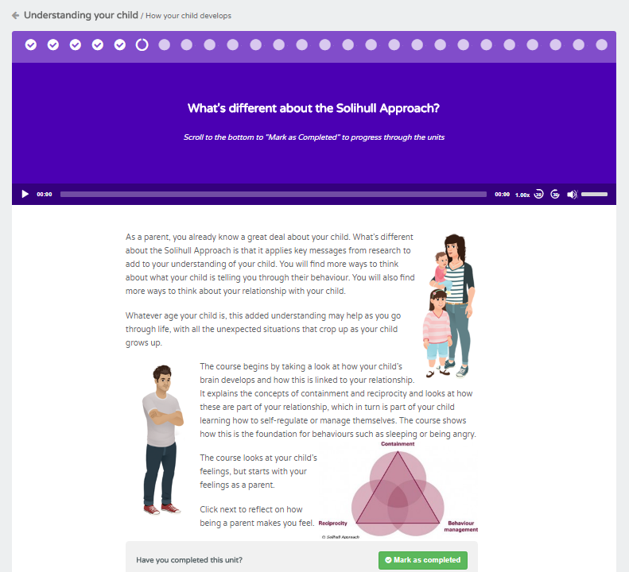

Name of course and module title
Module progress bar. Ticks = completed units, circles = units yet to complete
Name of unit
Audio bar, plays automatically, can be switched off in settings

Slide 15
How to find out more
www.solihullapproachparenting.com
www.inourplace.co.uk
For help with technical issues contact solihull.approach@heartofengland.nhs.uk 0121 296 4448
    (The most common issue can be resolved by accessing the courses via a modern browser such as Google Chrome, Firefox, or Explorer 10)
    Any other queries contact the BCUHB Public Health Team at nwsol@wales.nhs.uk

