Slide 1
Digital Literacy

Slide 2
Successful Futures
The Donaldson Review

Slide 3
Highlights
"Children and young people need to learn how to be more than consumers of technology and to develop the knowledge and skills required to use that technology creatively as learners and future members of a technologically competent workforce."
"Digital competence is increasingly fundamental to learning and life and...it should have similar status within the curriculum to that of literacy and numeracy."
"A digital competence progression framework and an accompanying ‘Routes to Learning Digital Competence’ [will] need to be developed."
Professor Graham Donaldson

Slide 5
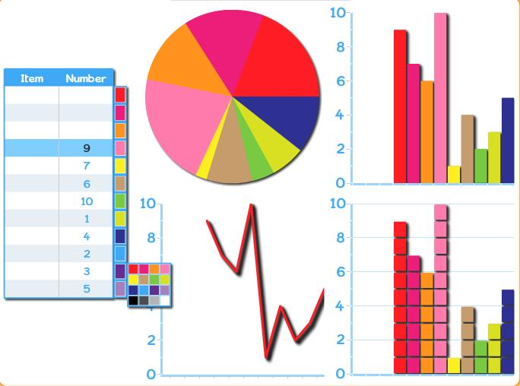
Apps, Games & Software
Cargo-Bot
Kodable
Logic and problem solving skills
Critical thinking skills
Sequencing of events
Conditional Statements – “If this is true, that will happen”
Loops – repeating a set of commands

Slide 8
Office 365

Slide 10
